Slide 1
^{DSI Capstone} ^{11/07 Weekly Update}
Nov 10, 2022

Slide 2
Agenda
1
From Last Week
2
Modeling Deep Dive: Optimization on Gurobi
3
Business Case
4
Next Steps

Slide 3
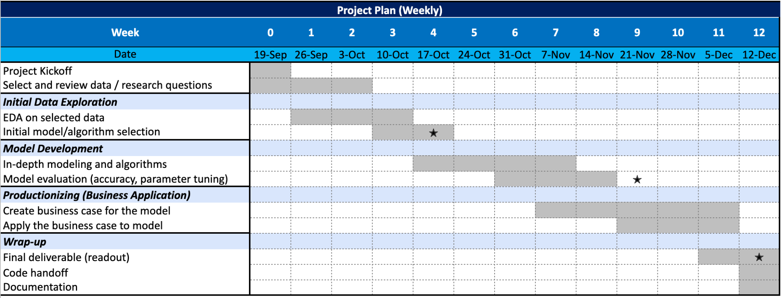
From Last Week: Timeline
1
1st progress report
2nd progress report

Slide 4
From Last Week
1
Action items:
Apply the current optimization model on other available routes: I-5, I-90 and I-82 route
Improve the model by incorporating # of chargers
Prepare data for business implementation phase

Slide 5
Modeling Deep Dive: Optimization on Gurobi
2
Variable
Each gas station location
(output will be charger numbers in each location)
Average EV traffic coverage per charger within 1 miles based on current state (ratio¹):
168
Objective function
Minimize new charger count in stations
Constraints
Fixed constraints:
Driving distance to highway exit < 5 miles
Risk rating from NRI is not Very High²
No additional new EV stations appearing in 2.5-mile straight line radius
Constraints varied by variables:
All traffic demand satisfied:
(New EV charger cnt + # of existing EV charger within 5 miles)* ratio¹ >= EV traffic cnt
1. total traffic ratio = traffic count within 1 miles / # of EV stations within 1 miles for each Seattle (busy) area I-5 exits
take the average of each ratio on exits and come to the final ratio
To approximate the EV traffic, we multiply the total traffic by 1.5%
2. This fixed constraint can be applied during business implementation phase

Slide 6
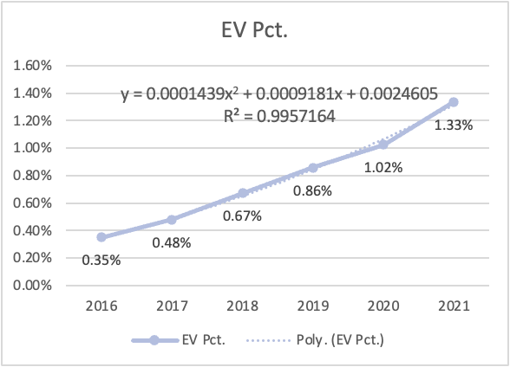
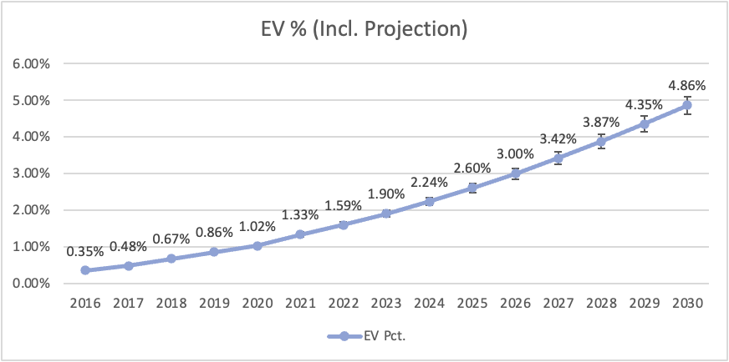
Modeling Deep Dive: Future EV% Projection
2
Year | EV Pct.
2016 | 0.35%
2017 | 0.48%
2018 | 0.67%
2019 | 0.86%
2020 | 1.02%
2021 | 1.33%
2022 | 1.59%
2023 | 1.90%
2024 | 2.24%
2025 | 2.60%
2026 | 3.00%
2027 | 3.42%
2028 | 3.87%
2029 | 4.35%
2030 | 4.86%
The projected percentage of EVs, from 2022 to 2030, is quadratic-interpolated from registered vehicles in WA state, from 2016 to 2021.
Includes EV and plug-in hybrid vehicles
5% Error bars are added
Data Source: (Alternative Fuels Data Center) https://afdc.energy.gov/transatlas/#/?state=WA&view=vehicle_count&fuel=ELEC

Slide 7
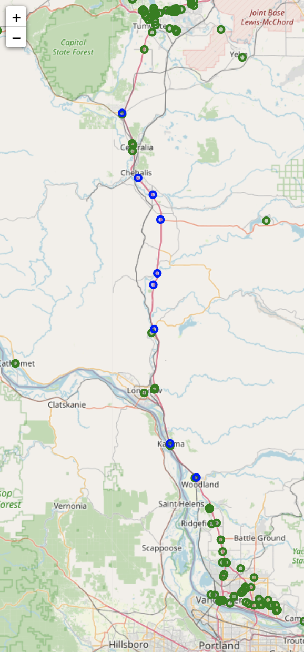
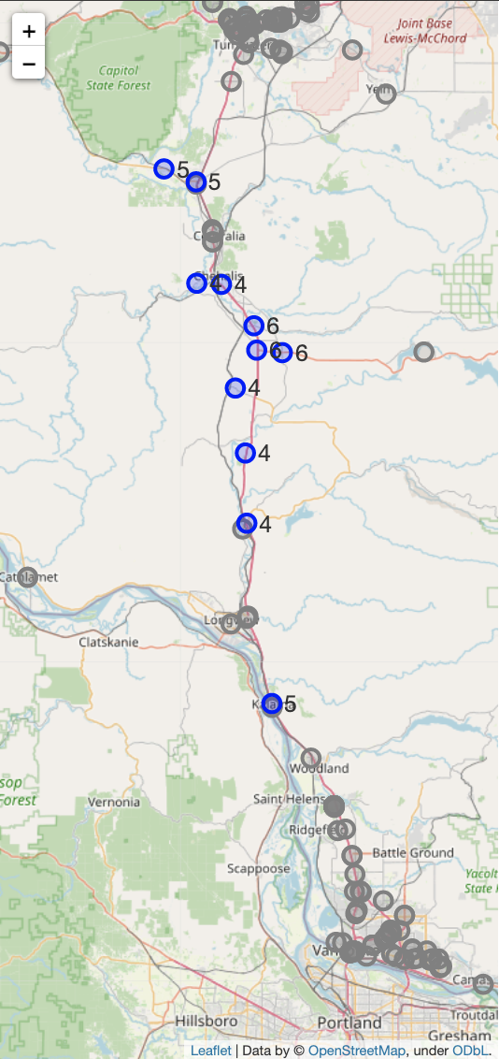
Result - Current Demand Scenario (2022)
2
: Existing EV charging location
: Suggested new EV charging location
Model LAST WEEK
EV% = 0.8%
Suggested 9 locations
Model THIS WEEK
EV% = 1.6%
Suggested 11 locations
More locations appeared because we extended the constraint of distance to highway from 1 to 5 miles driving distance
Now we have the # of chargers on the proposed locations
* Graph is in I-5 South area as an example
Model version: pandas: 1.3.5, gurobipy: 9.5.2 (detail see appendix)

Slide 8
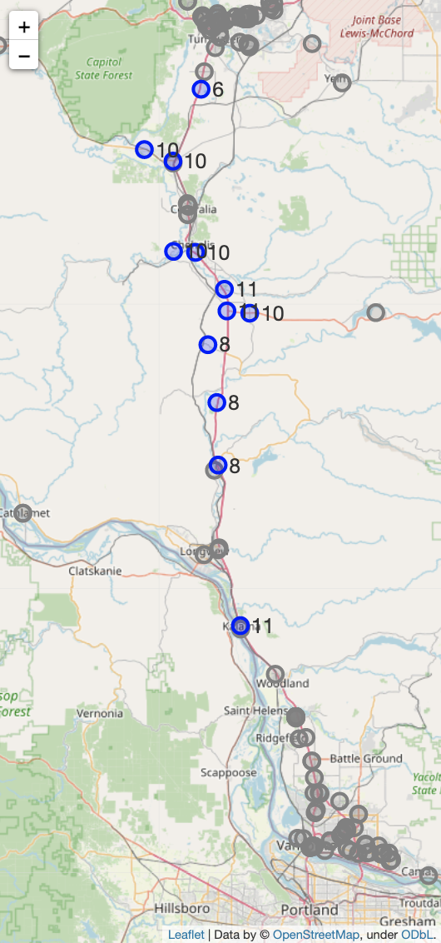
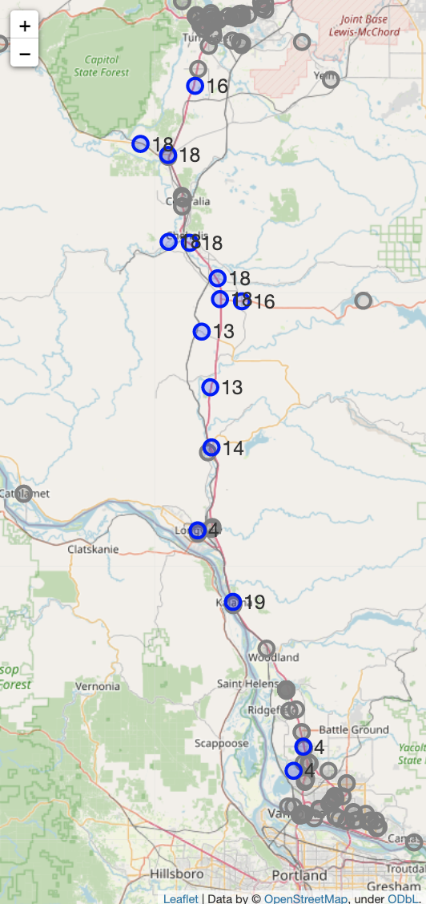
Result - Future Demand Scenario
2
: Existing EV charging location
: Suggested new EV charging location
Future: 2026
EV% = 3%
Suggested 12 locations
Future: 2030
EV% = 5%
Suggested 15 locations
No significant difference between 2022 and 2026 scenarios - only # of chargers in each location increases
As demand increases, # of chargers in each location increases
Extra proposed EV charging locations are around urban areas
Model version: pandas: 1.3.5, gurobipy: 9.5.2 (detail see appendix)

Slide 9
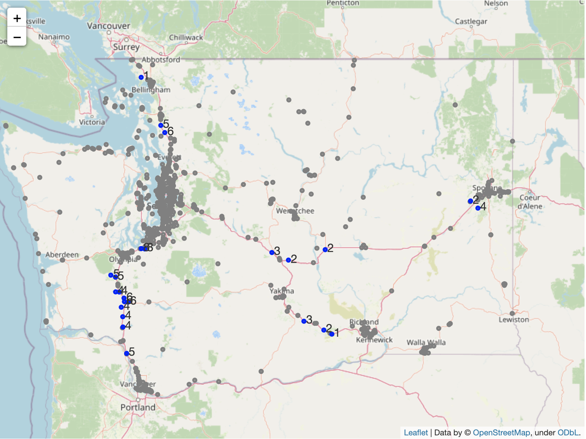
Result - Other Routes: Current Demand Scenario (2022)
2
: Existing EV charging location
: Suggested new EV charging location
I-5
EV% = 1.6%
Suggested a total of 24 additional EV charging station locations
No suggested new EV charging location in Seattle area because we already used this area to calculate optimal ratio¹
I-90
Lack of existing gas station locations used as candidates
I-82
Model version: pandas: 1.3.5, gurobipy: 9.5.2 (detail see appendix)
1. total traffic ratio = traffic count within 1 miles / # of EV stations within 1 miles for each Seattle (busy) area I-5 exits

Slide 10
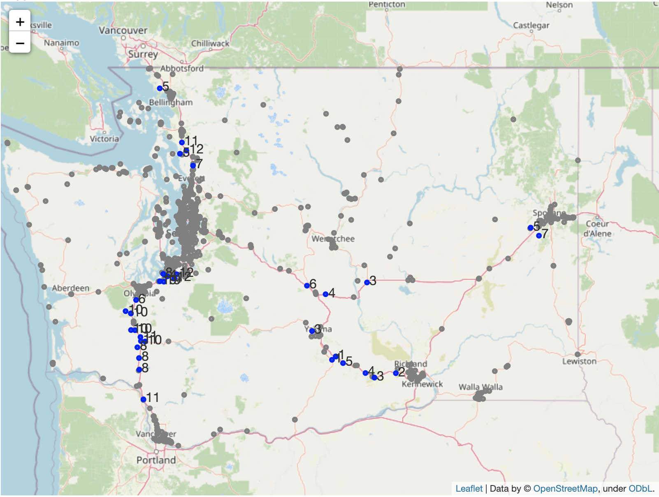
Result - Other Routes: Future Demand Scenario (2026)
2
EV% = 3%
Suggested a total of 35 additional EV charging station locations
: Existing EV charging location
: Suggested new EV charging location
I-5
I-90
No significant difference from current demand scenario (2022), but # of chargers increased on each location and more locations added along I-82
I-82
Model version: pandas: 1.3.5, gurobipy: 9.5.2 (detail see appendix)

Slide 11
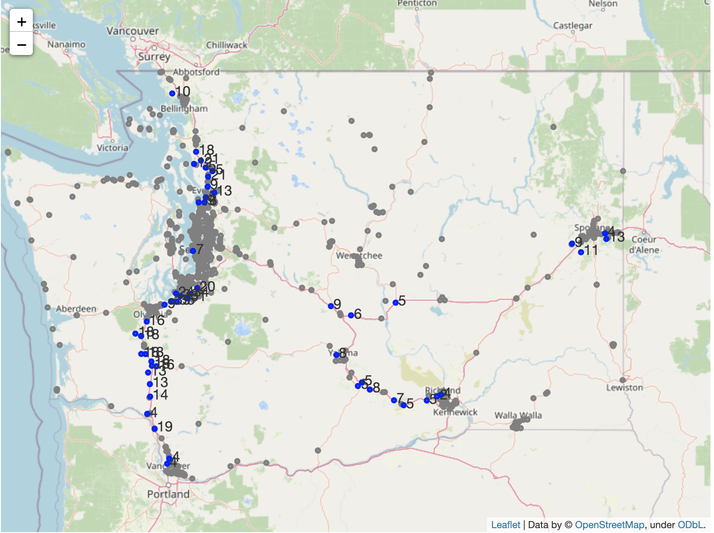
Result - Other Routes: Future Demand Scenario (2030)
2
EV% = 5%
Suggested a total of 52 additional EV charging station locations
: Existing EV charging location
: Suggested new EV charging location
I-5
I-90
As demand further increases, the differences are
Most demand increased in urban area
# of chargers along I-5 increased more than on other routes
I-82
Model version: pandas: 1.3.5, gurobipy: 9.5.2 (detail see appendix)

Slide 12
Business Case
3
Proposed Questions to Solve
Among all the proposed locations the model produced, work out an indicator to suggest whether the location is suitable for actually building a charging station. What will be the factors and actual gain/lost?
Factors to consider
Proposed Approaches
Natural Risk Index
Crime rate
Energy capacity
Nearby attractions or eating places
Nearby parking lots
Cost of building the station and chargers
Between 0-1, create a score indicating whether the place is better
Utilize the classification model build previously
Concern: lack of optimal training data
Create a scoring system using linear combinations with factors and create different prize/penalty on each factors

Slide 13
Next Steps
4
Action items:
Model comparison: consider other objective functions and compare the evaluation metrics (required by Columbia professor)
Proceed with business case
Gather enough data and work out a first/naive version of insights and solutions

Slide 14
Appendix

Slide 15
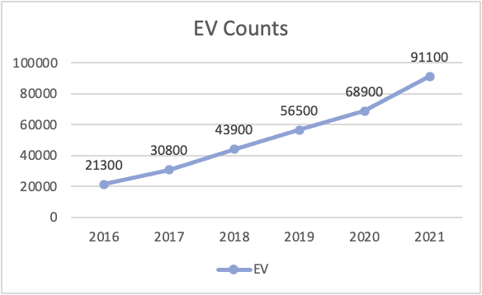
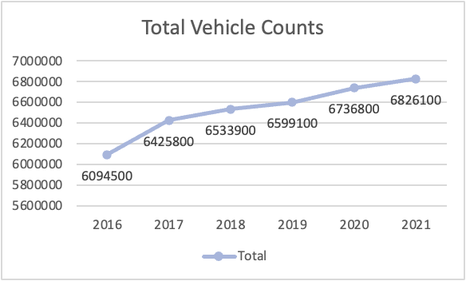
Modeling Deep Dive: Future EV% Projection - EV count projection

Slide 16
Python Libraries Used
pandas: 1.3.5
numpy: 1.21.6
gurobipy: 9.5.2
geopy: 1.17.0
folium: 0.12.1.post1
requests: 2.23.0
json: 2.0.9

